Slide 1
React Components, Props, and State
Alind Kumar Jain - 326835
Shilpa Mandara – 716650
Jason Monroe - 688776

Slide 2
Course Objective:
At the end this 120 min session, you will be able to
Summarize the difference between functional and class components
Create a functional component and a class component
Pass props to a component
Add state to a class component

Slide 3

Benefits
Must-know for React development
Components are the building blocks
State and props are necessary for data movement throughout an app

Slide 4
Key Topics
React Components
Functional Components
Props
Class Components
State and Props

Slide 5
React Components

Slide 6
Component
A component is a JavaScript class or function that optionally accepts inputs i.e. properties (props) and returns a React element (DOM) that describes how a section of the UI should appear.
Props
Component
DOM

Slide 7
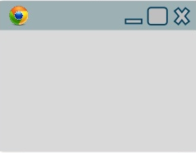
An application's UI can be split up into smaller components where each component has its own code, structure
< App />
<one/>
<Four/>
<Two/>
<Five/>
<Three/>
<Six/>

Slide 8
All these components can be integrated together to build one application.
These components can be easily updated without disturbing rest of Application.
<Six/>
<Four/>
<one/>
<Two/>
<Five/>
<Three/>

Slide 9


Components in React basically returns a piece of JSX code which tells what should be rendered on the screen. In React there are two main types of components:
Functional Components
Class Components
Component
Functional
Class

Slide 10
Functional Components

Slide 11
Functional Component
These components are simply represented by a JavaScript function that optionally takes parameters (props) and returns a React element to be rendered to the page.
function FunctionalComponent()
{
return <h1> Hello World </h1>
}
Props
DOM
Since, Functional Component simply return a React Element , they are predictable and concise.

Slide 12
Functional components are also referred to as stateless, dumb or presentational in other literature. All these names are derived from the simple nature that functional components take on.
Functional because they are basically functions
Stateless because they do not hold and/or manage state
Presentational because all they do is output UI elements
Since, they are purely presentational, their output is always the same given the same props.

Slide 13
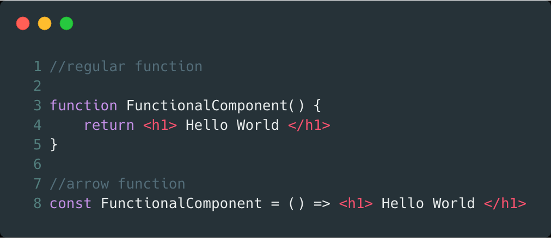

Two ways two create a functional component: Traditional Function Arrow Function (like a lamda)
When naming a React component, it is convention to capitalize the first letter. This is important because it enables React to differentiate between the native HTML tags such as div, h1, span etc and custom components like ClassComponent.

Slide 14
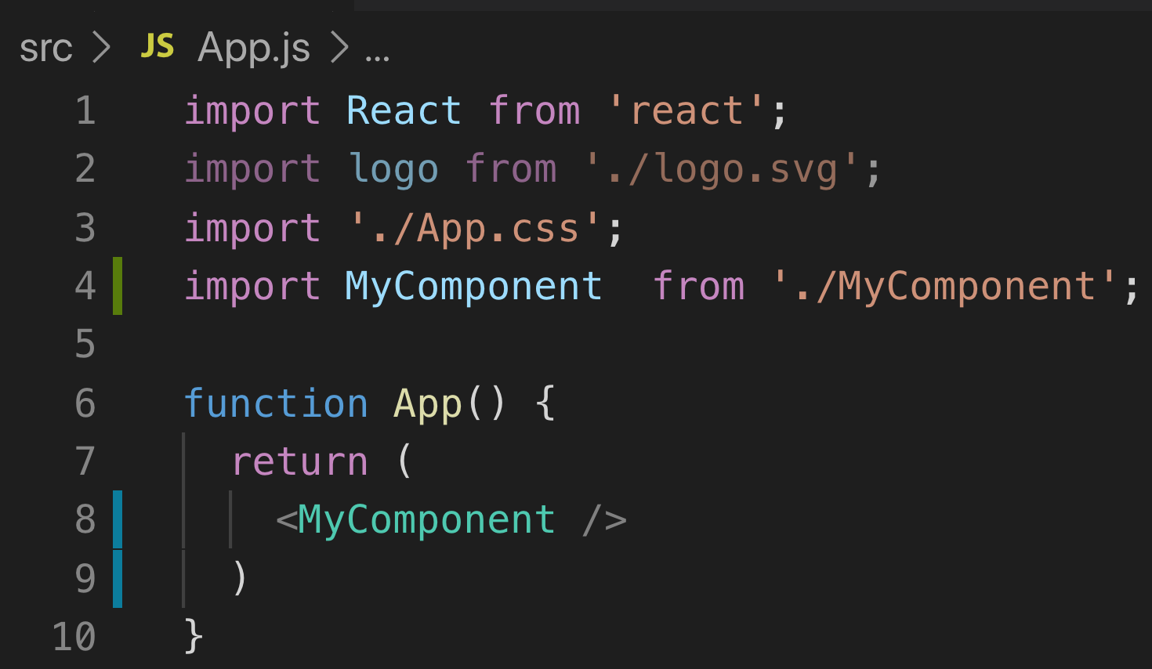
<ComponentName /> - syntax to use a React Component
Import Component
Use (display) component

Slide 15

Code Along Practice – Developer Bio Component
Create a new functional component that displays your developer bio with the following info:
First Name
Last Name
Favorite Development Language
Year Started
Add this component to the App component so that it is rendered.

Slide 16
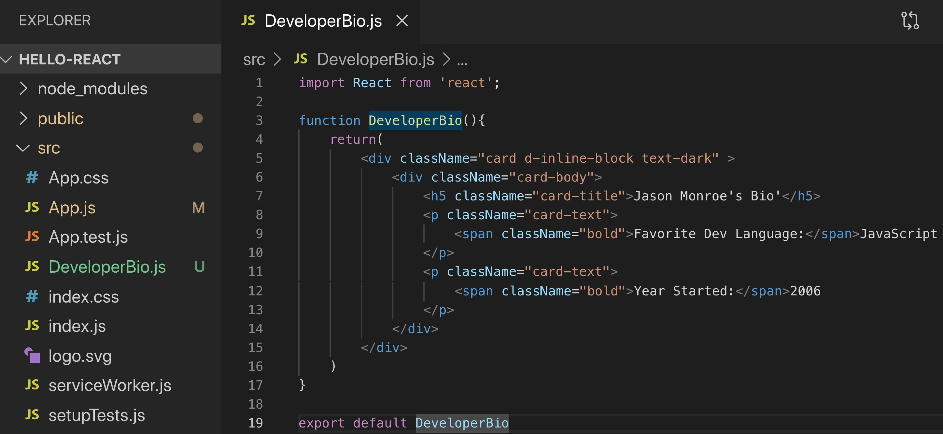
1. DeveloperBio Functional Component

Slide 17
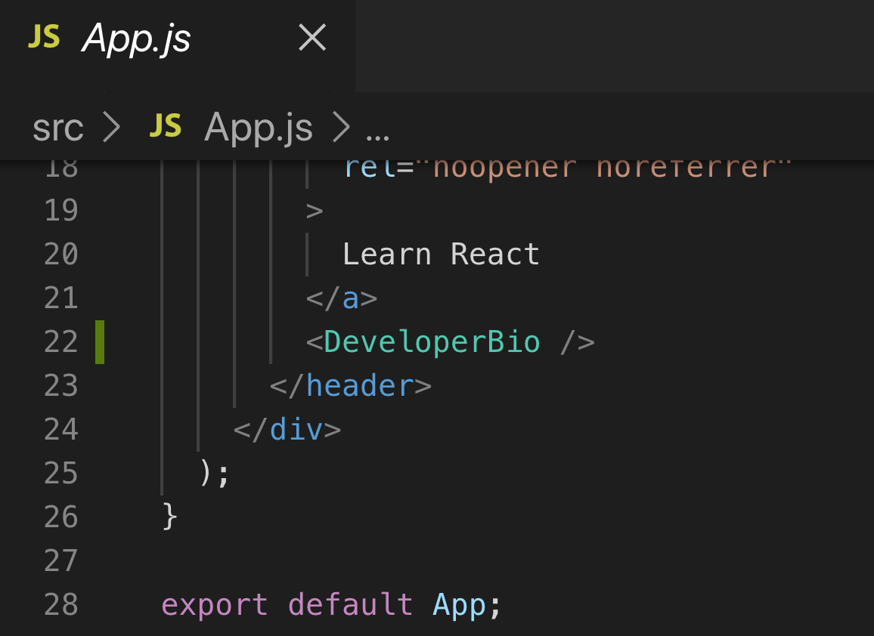
2. Add Component to App

Slide 18
2. Add Component to App
Add Bootstrap CDN link to index.html
so that class rules will render

Slide 19
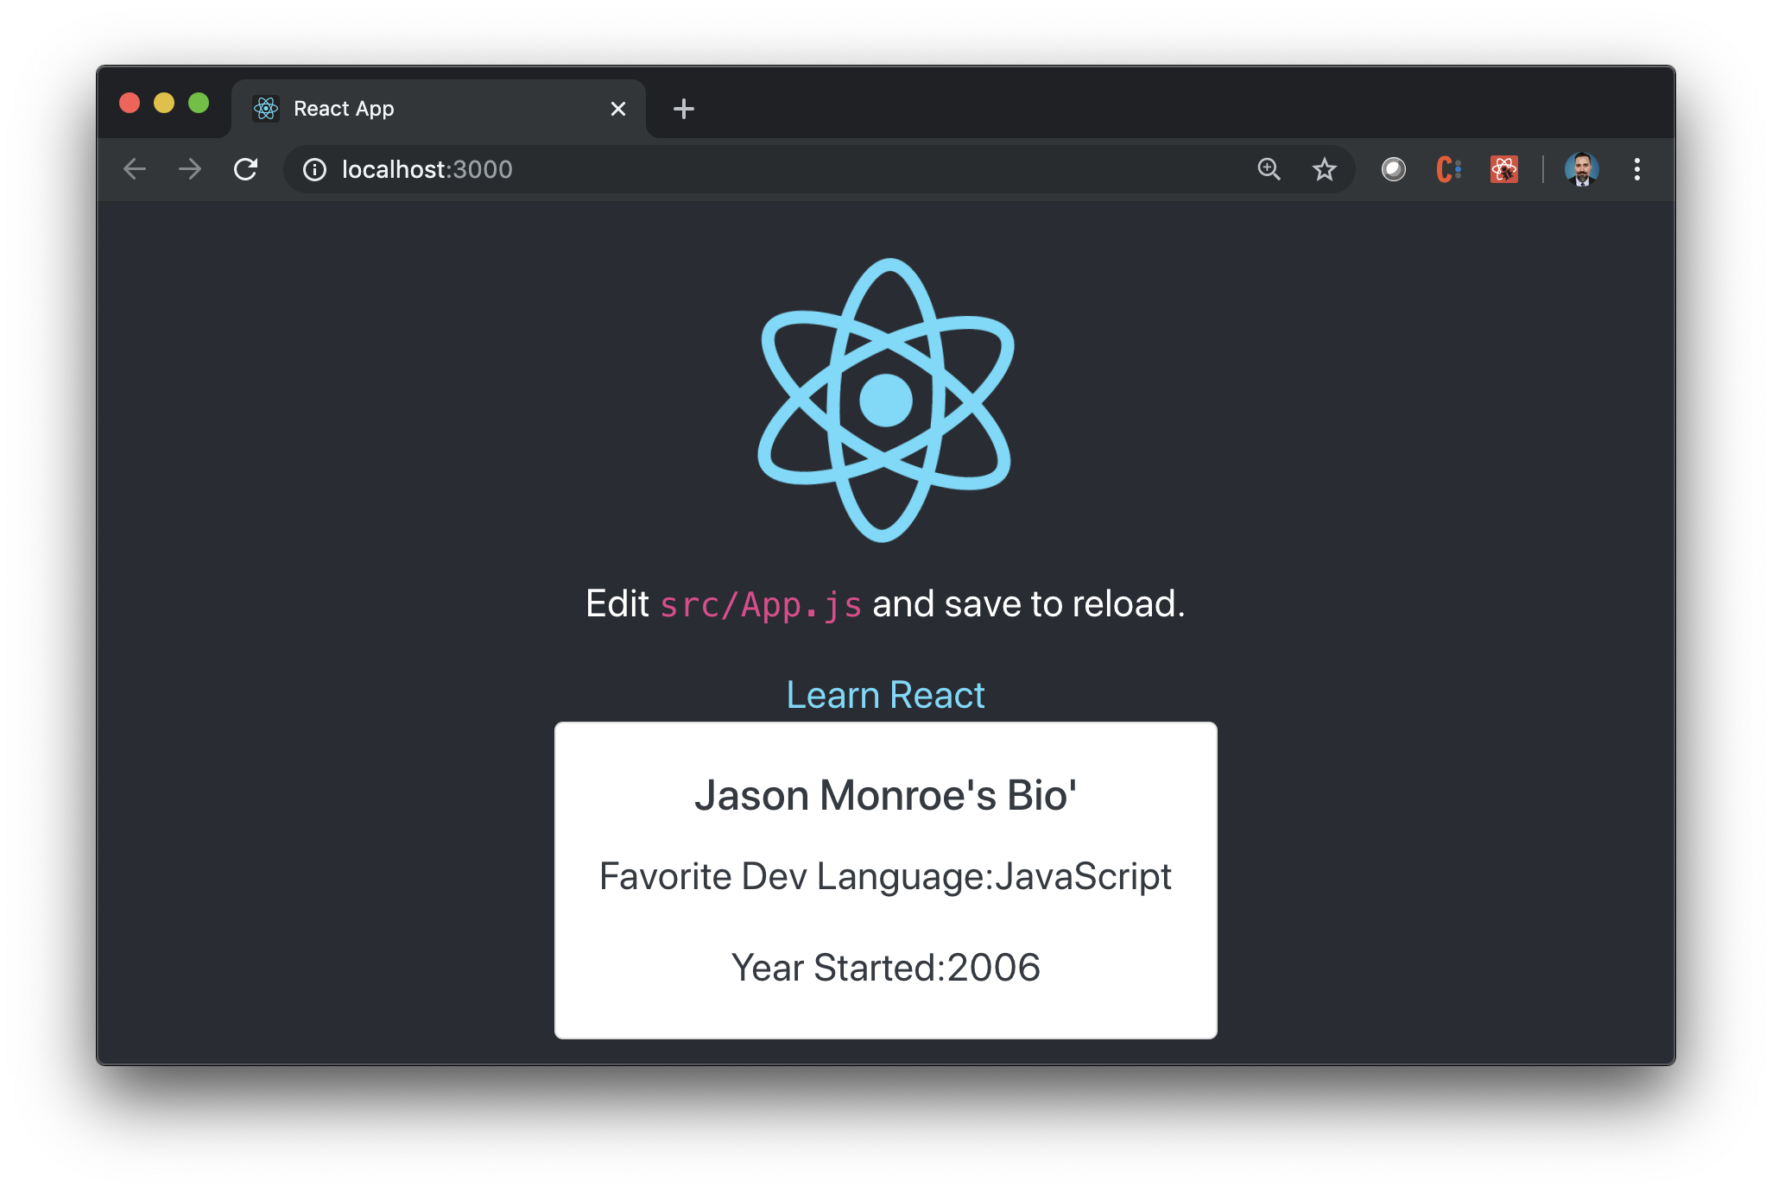
Finished product

Slide 20
Using ESLint

Slide 21
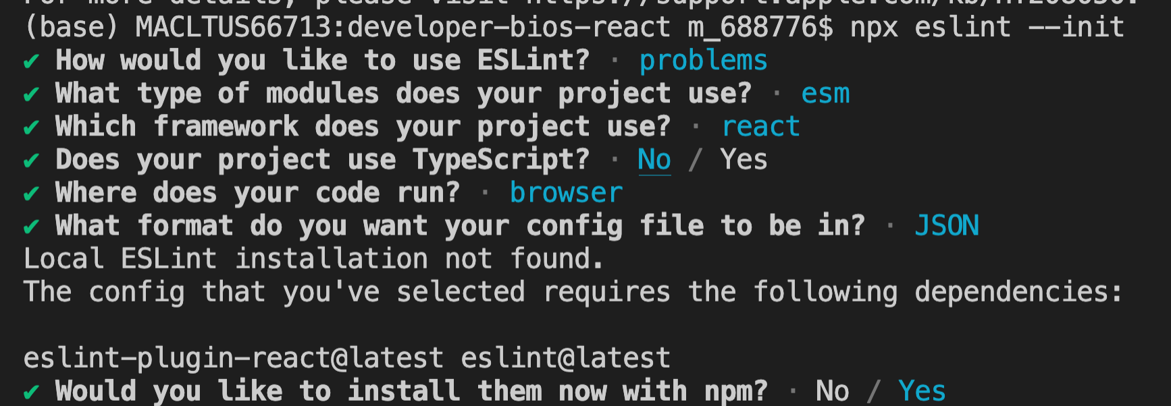
ESLint
Tool for identifying and reporting on patterns found in your JS code.
Used to enforce style and find potential bugs
Start by executing command npx eslint –init
Answer questions based on your project preferences

Slide 22
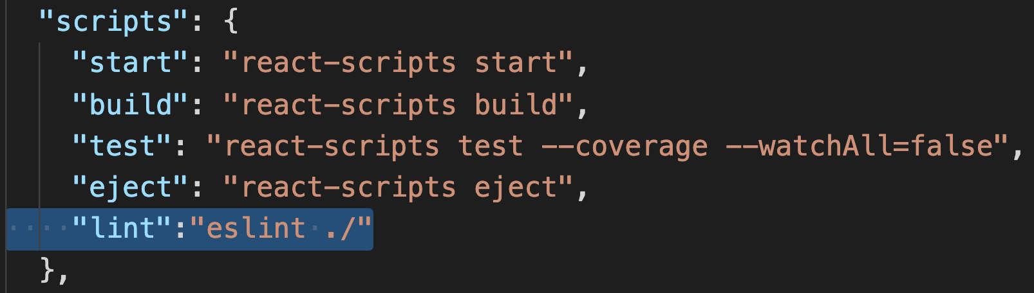
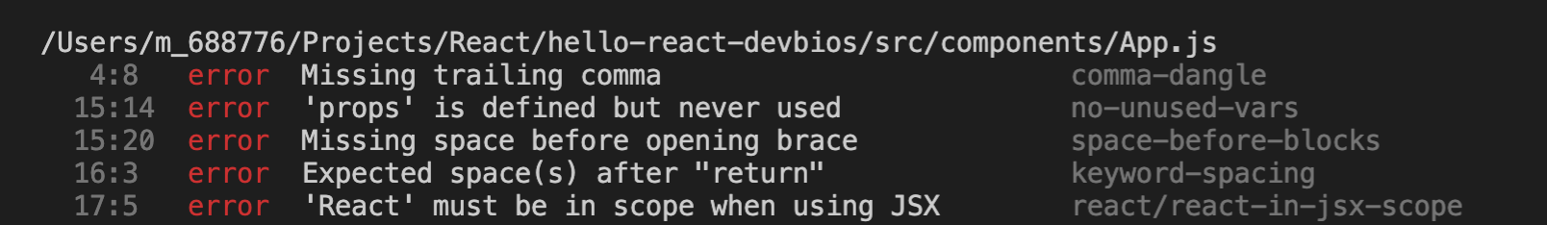
ESLint
Update package.json so that you can run eslint from command line
Run linting with npm run lint

Slide 23
Props

Slide 24
Props
A component may choose to pass data down as props to its child components.
This is commonly called a “top-down” or “unidirectional” data flow. Data is always owned by some specific component, and any data or UI derived from it can only affect components “below” them in the tree.
If you imagine a component tree as a waterfall of props, each component’s data is like an additional water source that joins it at an arbitrary point but also flows down.

Slide 25
Pass Props Inside Component Usage
Any Key/Value pair can be used as a prop

Slide 26
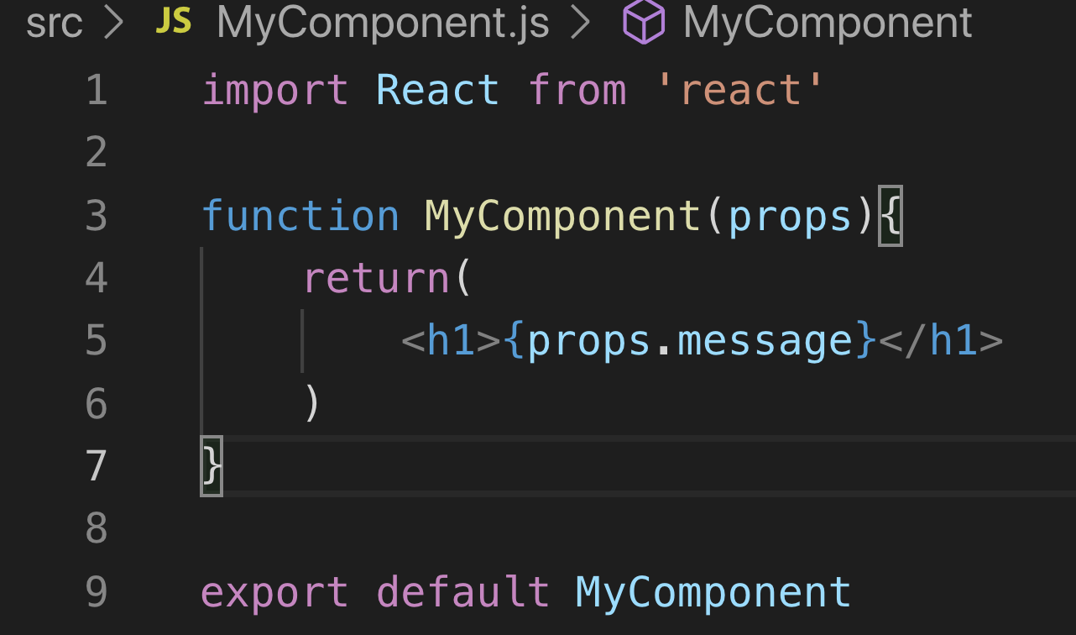
Pass Props into Component Constructor and Use as a Parameter
Accessing Props

Slide 27
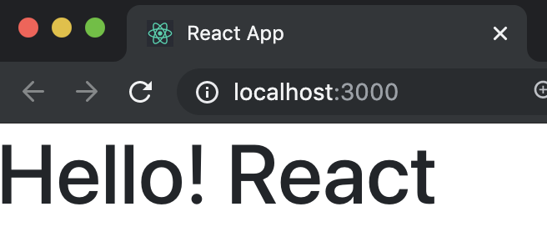
Result

Slide 28
Code Along Practice – Passing Props
Move card title innerHTML to App.js and pass as props to DeveloperBio
Add props to DeveloperBio() function parameters and access to display title.

Slide 29
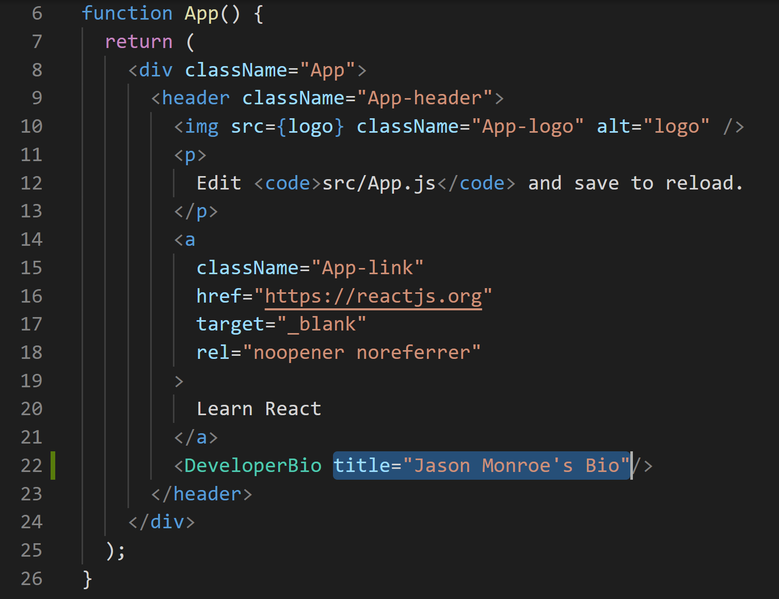
#1

Slide 30
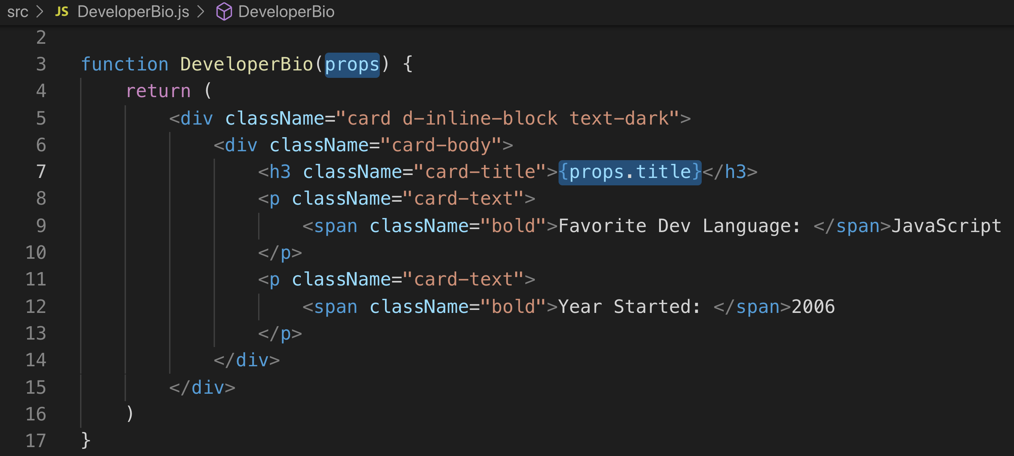
#2

Slide 31
Class Components

Slide 32
Scenario
Let’s say that we want to add multiple developer bios. It wouldn’t make sense to hard code those, and ultimately, that info should be coming from a database. So how do we handle displaying all data in a data set?
Class Components have the ability to store state (amongst other things), so let’s investigate this second type of component.

Slide 33
Class Components
Class Components
Constructed as a JavaScript Class
Can have a constructor that creates and initializes data
Methods that contain logic

Slide 34
Class components are referred to as smart, stateful, container components.
Class because they are basically classes
Smart because they can contain logic
Stateful because they can hold and/or manage local state
Container because they usually hold/contain numerous other (mostly functional) components

Slide 35
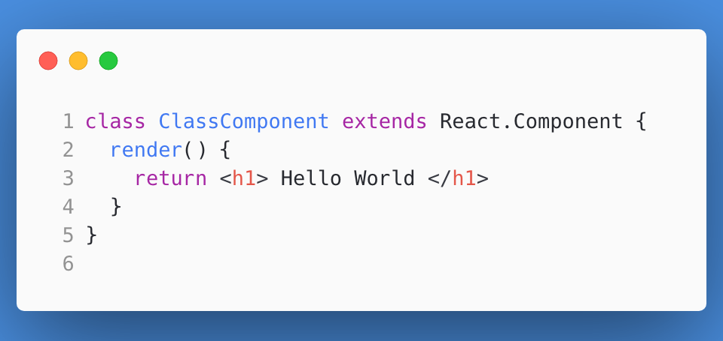
A class component in its simplest form:

Slide 36
State & Props

Slide 37
State
The State of an instance of a React Component Class can be defined as an object of a set of observable properties that control the behavior of the component.
In other words, State of a component is an object that holds some information that may change over the lifetime of the component.

Slide 38
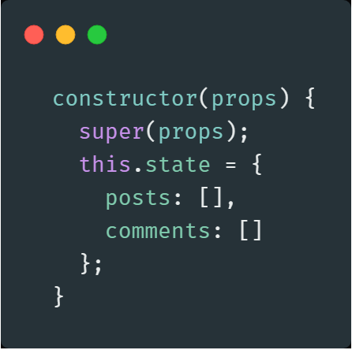
Creating State – State is created in class constructor and can be initialized there.
Always pass props in constructor and pass in call to super
https://overreacted.io/why-do-we-write-super-props/

Slide 39
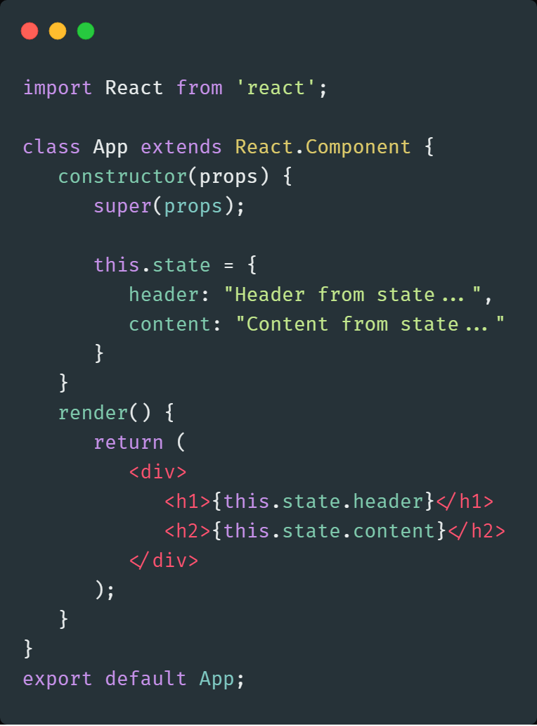
State Initialization
Accessing state

Slide 40
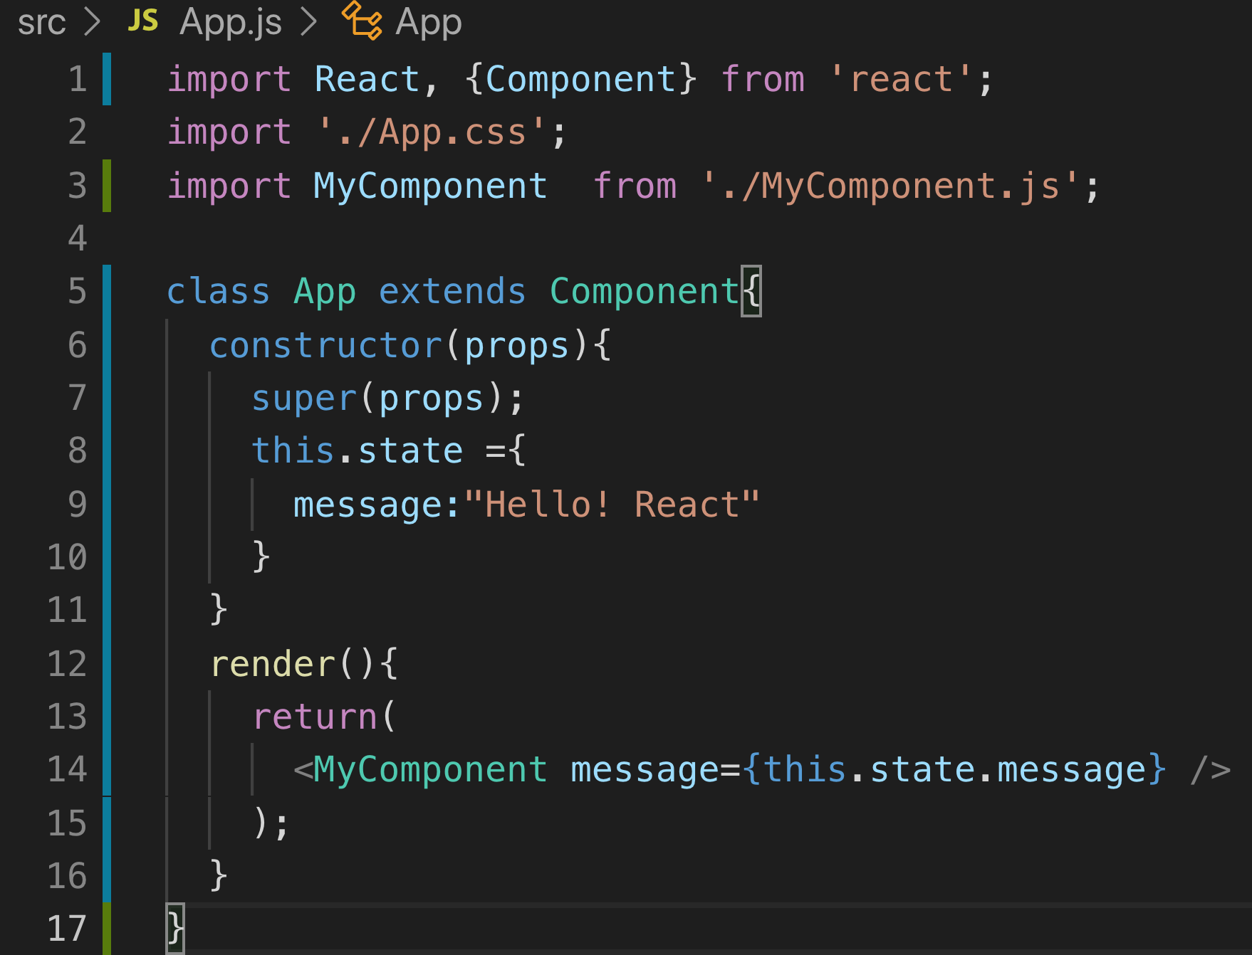
Passing State as Props

Slide 41
Passing State as Props

Slide 42


Difference between Props and State
ReactJS: Props vs. State
Props are immutable i.e. once set the props cannot be changed, while State is an observable object that is to be used to hold data that may change over time and to control the behavior after each change.
States can only be used in Class Components while Props don’t have this limitation.
While Props are set by the parent component, State is generally updated by event handlers.
Props
<Component />
State
Props
Props
<Component />
<Component />
State
State

Slide 43
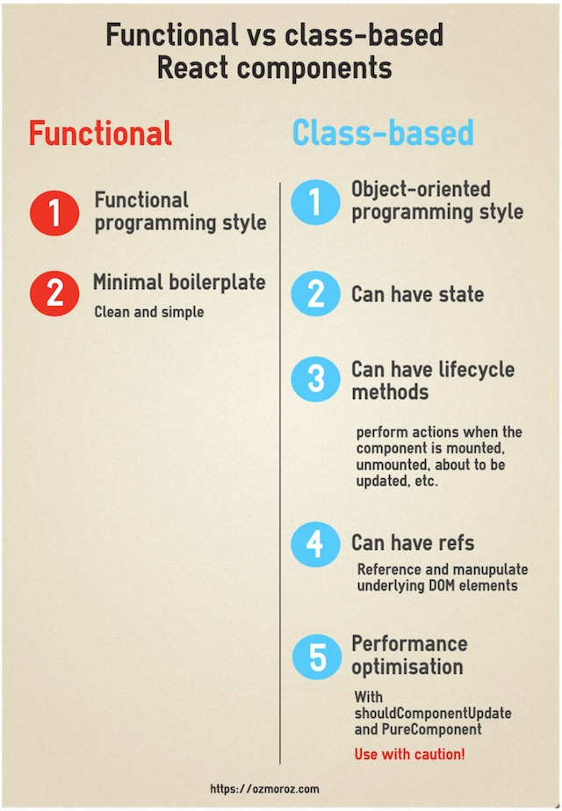
Which type of component to use?
It’s important to know whether to use class or functional components.
Use a class component if you:
need to write complex logic using local state
need to add lifecycle methods to your component
need to add logic for event handlers
Otherwise, always use a functional component.
Class components that only have markup within the render body can safely be converted to functional components.

Slide 44
Code Along Practice – BiosDisplay
Create a new class component called DisplayBios that contains state with an array of two developers.
In the render function, map each developer to a DeveloperBio component, passing the developer as a prop.
Update the DeveloperBio component to receive props and extract the developer from the props to display
Replace the DeveloperBio component inside of App.js with a DisplayBios component.

Slide 45
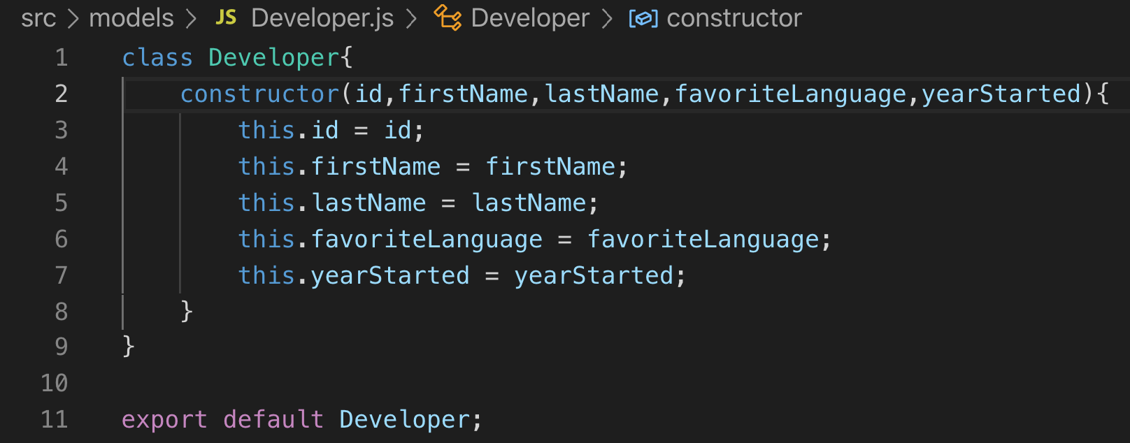
Developer Model

Slide 46
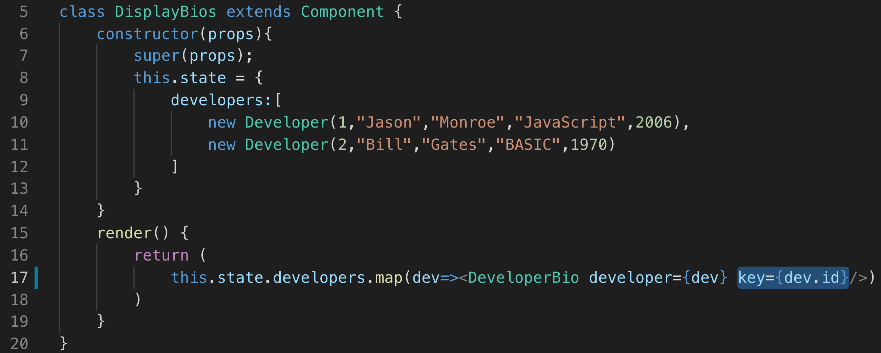
DisplayBios Class Component

Slide 47
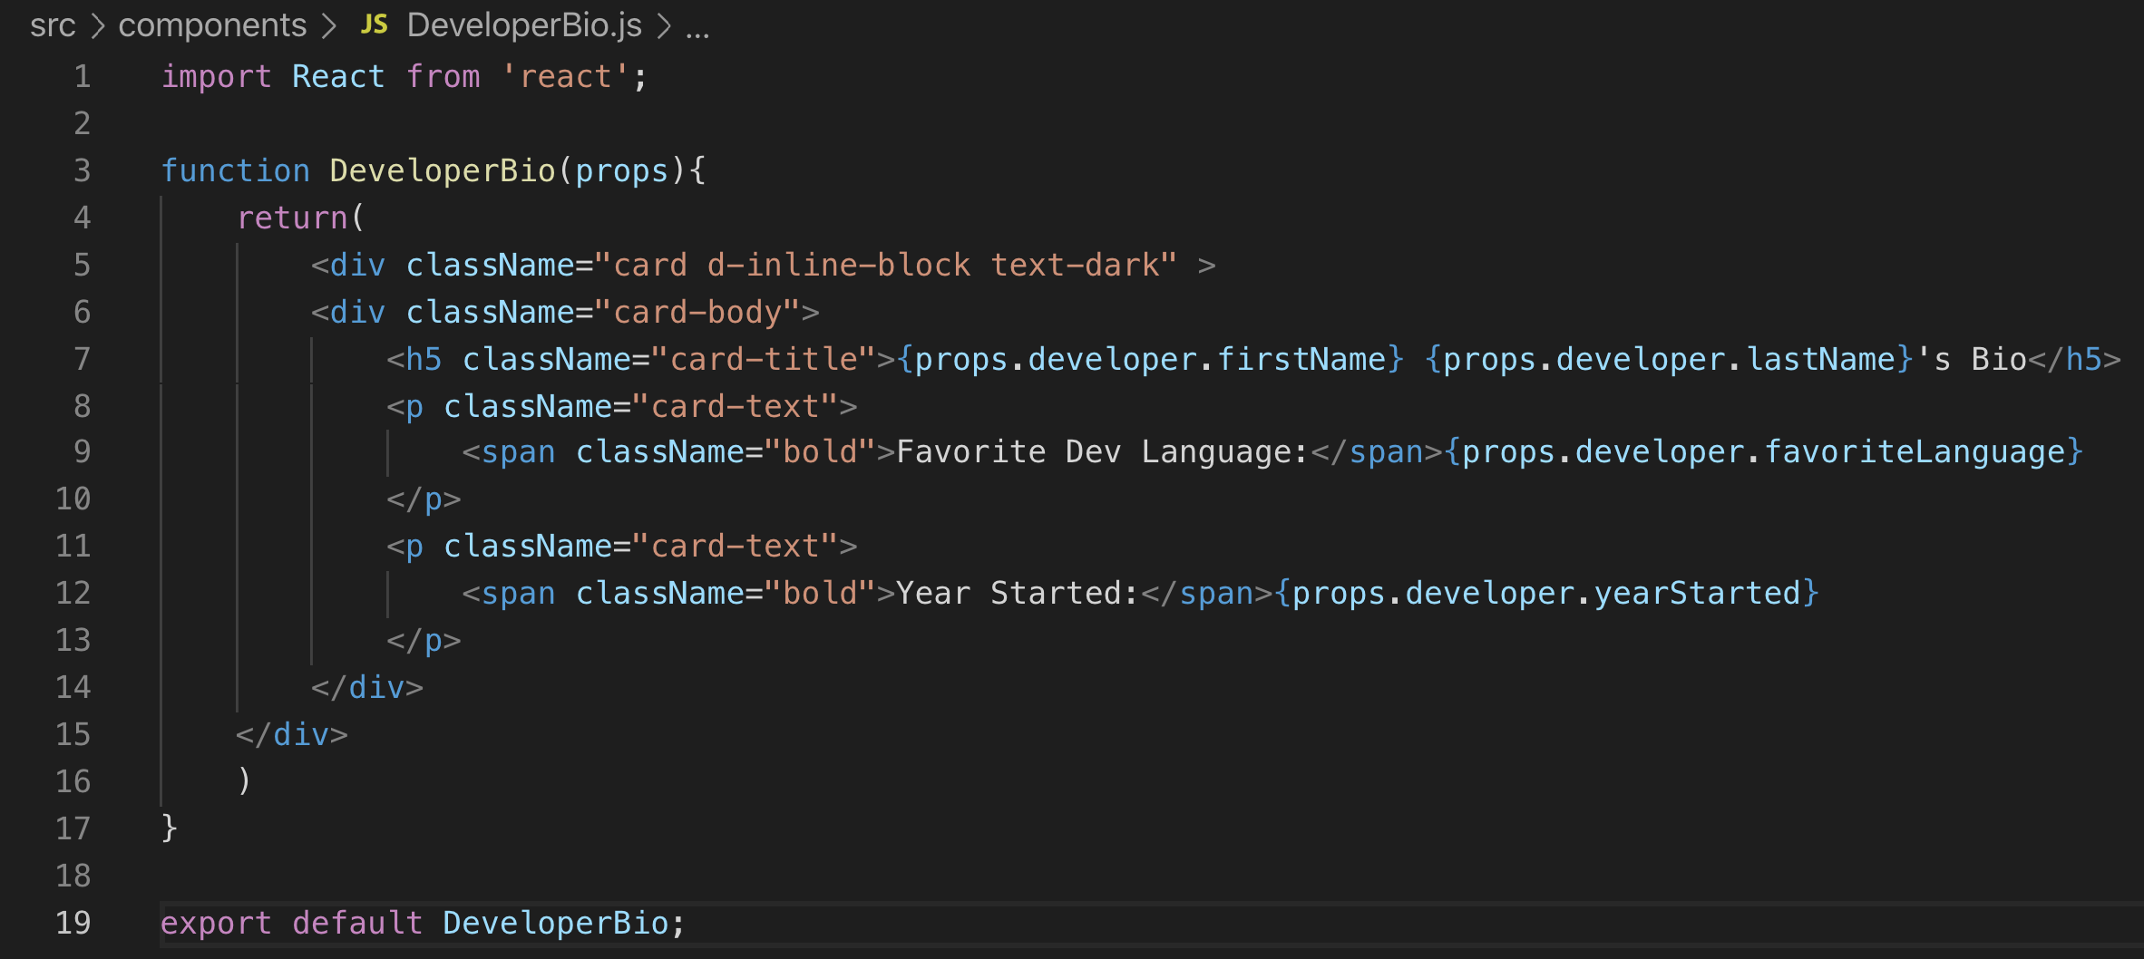
Display Developer from props

Slide 48
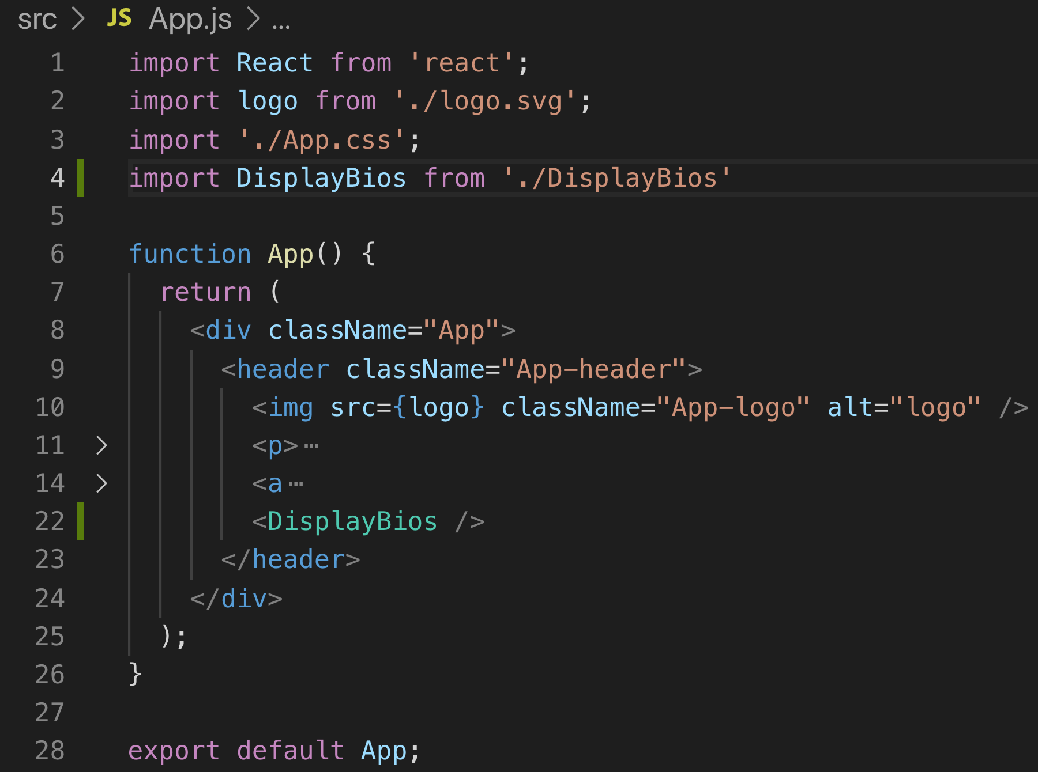
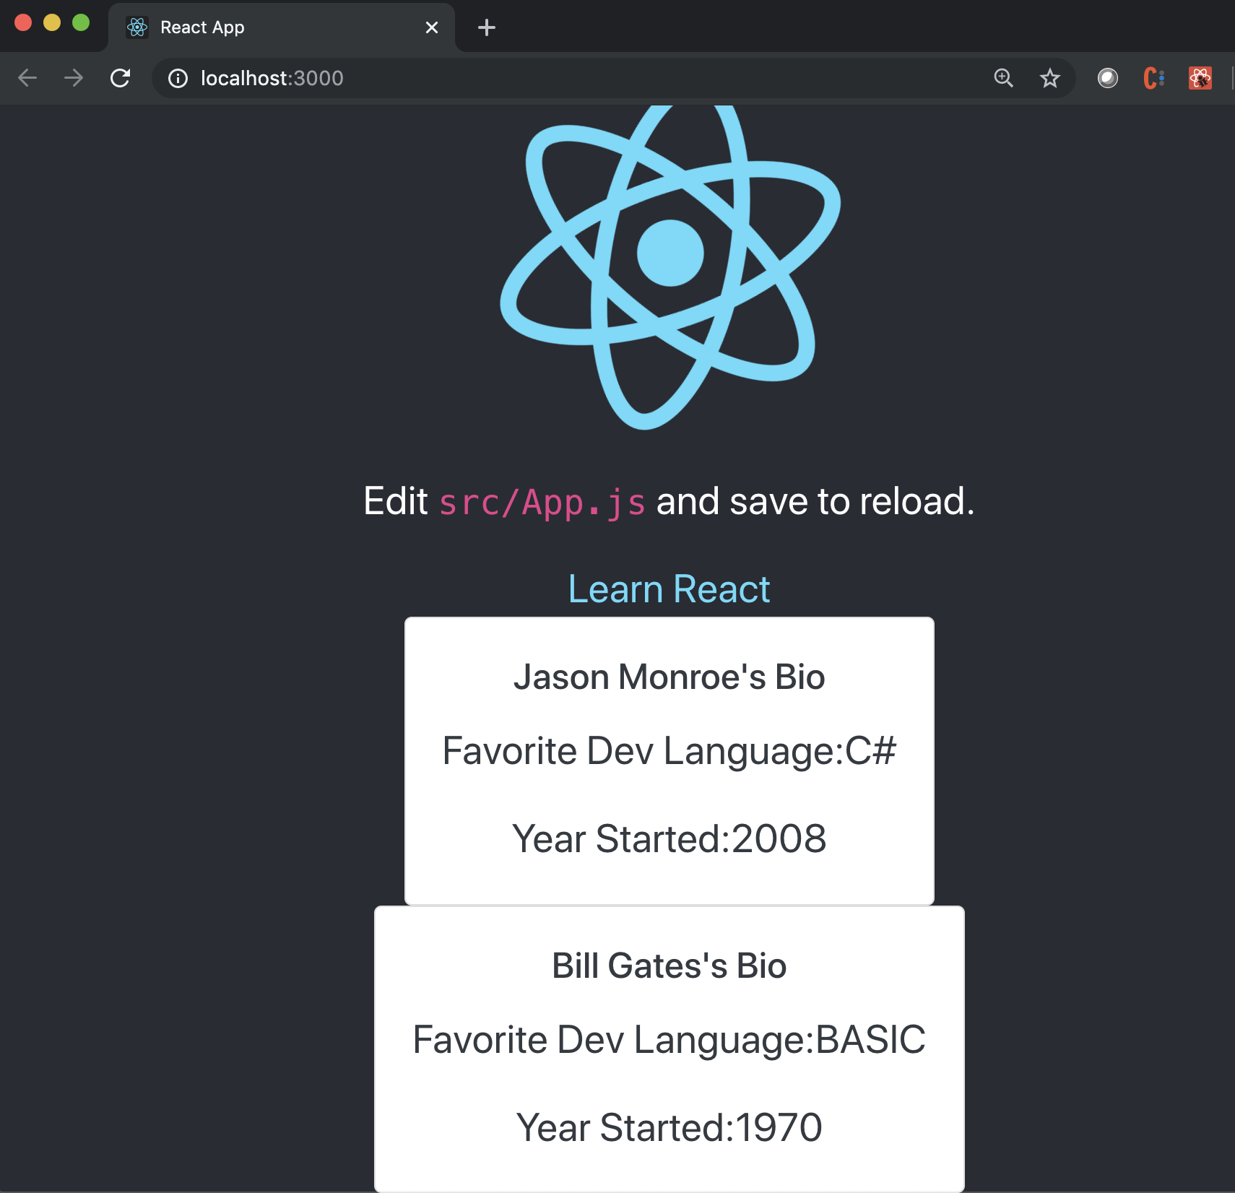
DisplayBios Component in App

Slide 49
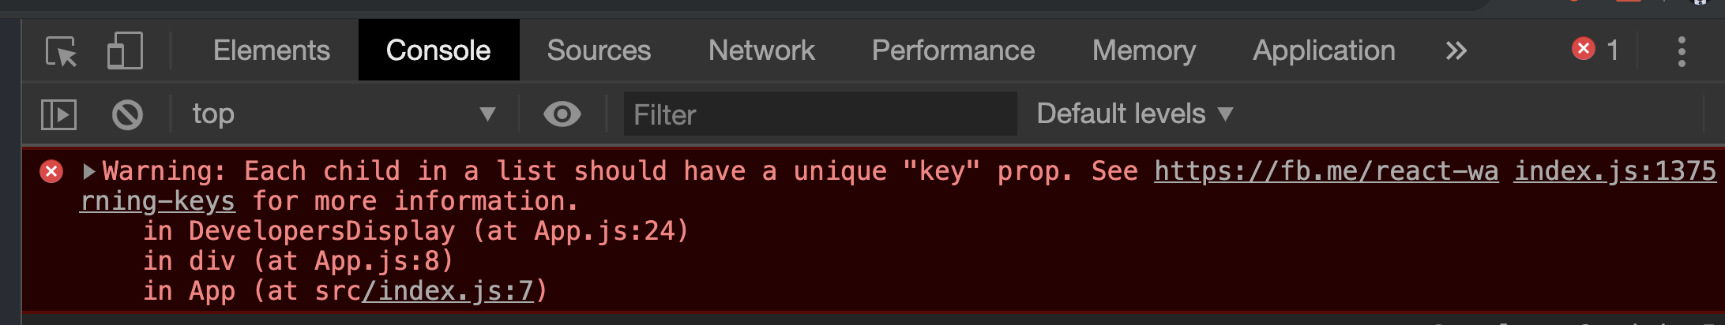
Keys Error!

Slide 50
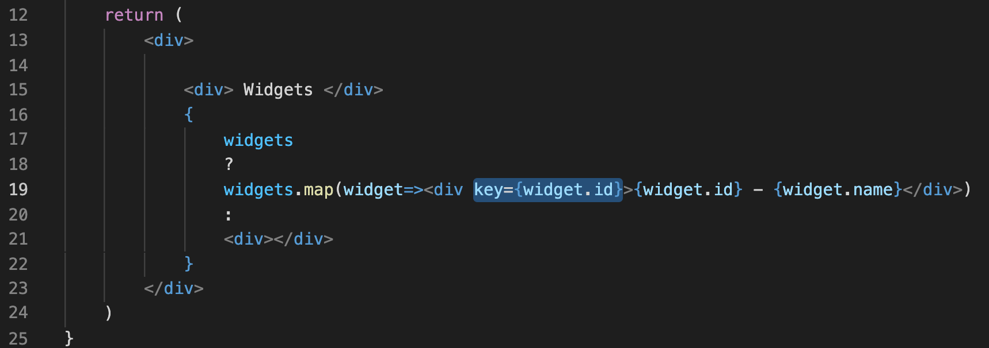
From an array of objects, you create a new array containing tags, which should have the key attribute, and their values are not allowed to be the same.
Keys

Slide 51
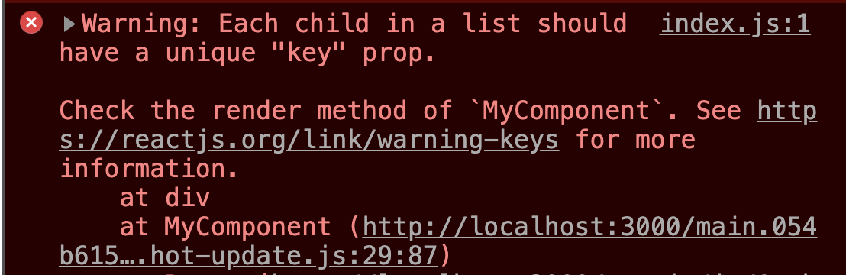
Keys helps React distinguish items in a list. It helps React manage the changed items, new items added, or items removed from the list.
Keys Error!

Slide 52
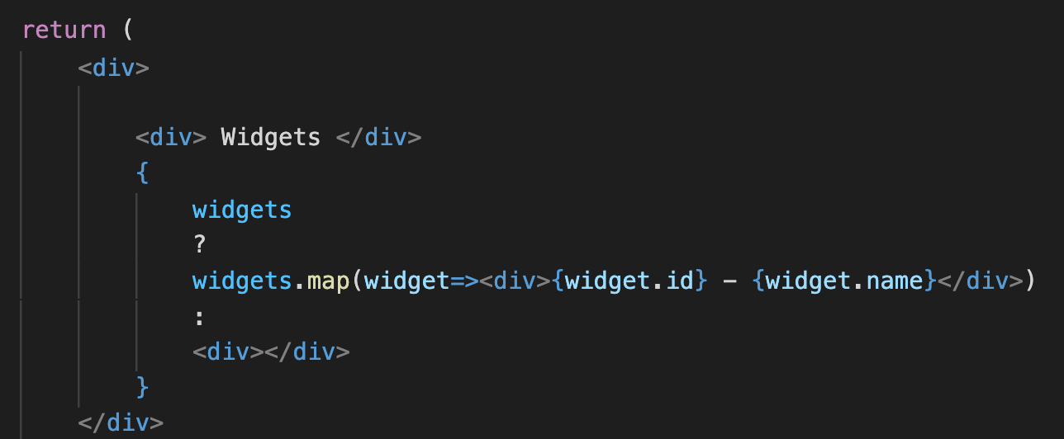
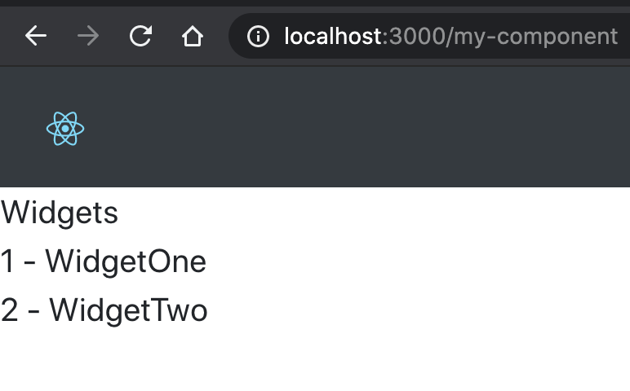
In JavaScript, you want to create a new array from an available array by converting each element of the original array to create the corresponding element of the new array, you can use map() method. For example, you may have an array of objects that you want to map to a React component that displays that object’s properties.
Mapping Arrays

Slide 53
On Your Own

Slide 54
On Your Own
Go to https://github.com/Cognizant-React/React-Super-Props
Follow the instructions in the README.md file to complete the project.

Slide 55

Practice Check
Suppose there is a <Clock /> functional component used as: <Clock currentTime=‘12:01pm’ />
How would you access the value 12:01pm from inside the component?
Clock.currentTime
currentTime
this.currentTime
props.currentTime
What is true about state in React? Please select all that apply:
A component's state can be defined at initialization
State is usually passed in from outside components
State should be used when you want to store information that will never change
A component can alter its own internal state

Slide 56
Review
Functional Components
Class Components
State
Props

Slide 57
Course Objective:
At the end this 120 min session, you will be able to
Summarize the difference between functional and class components
Create a functional component and a class component
Add state to a class component
Pass props to a component

Slide 58
What are the challenges to the one-way flow of data in React?
What are the benefits?

Slide 59
Thank You

